Slide 1
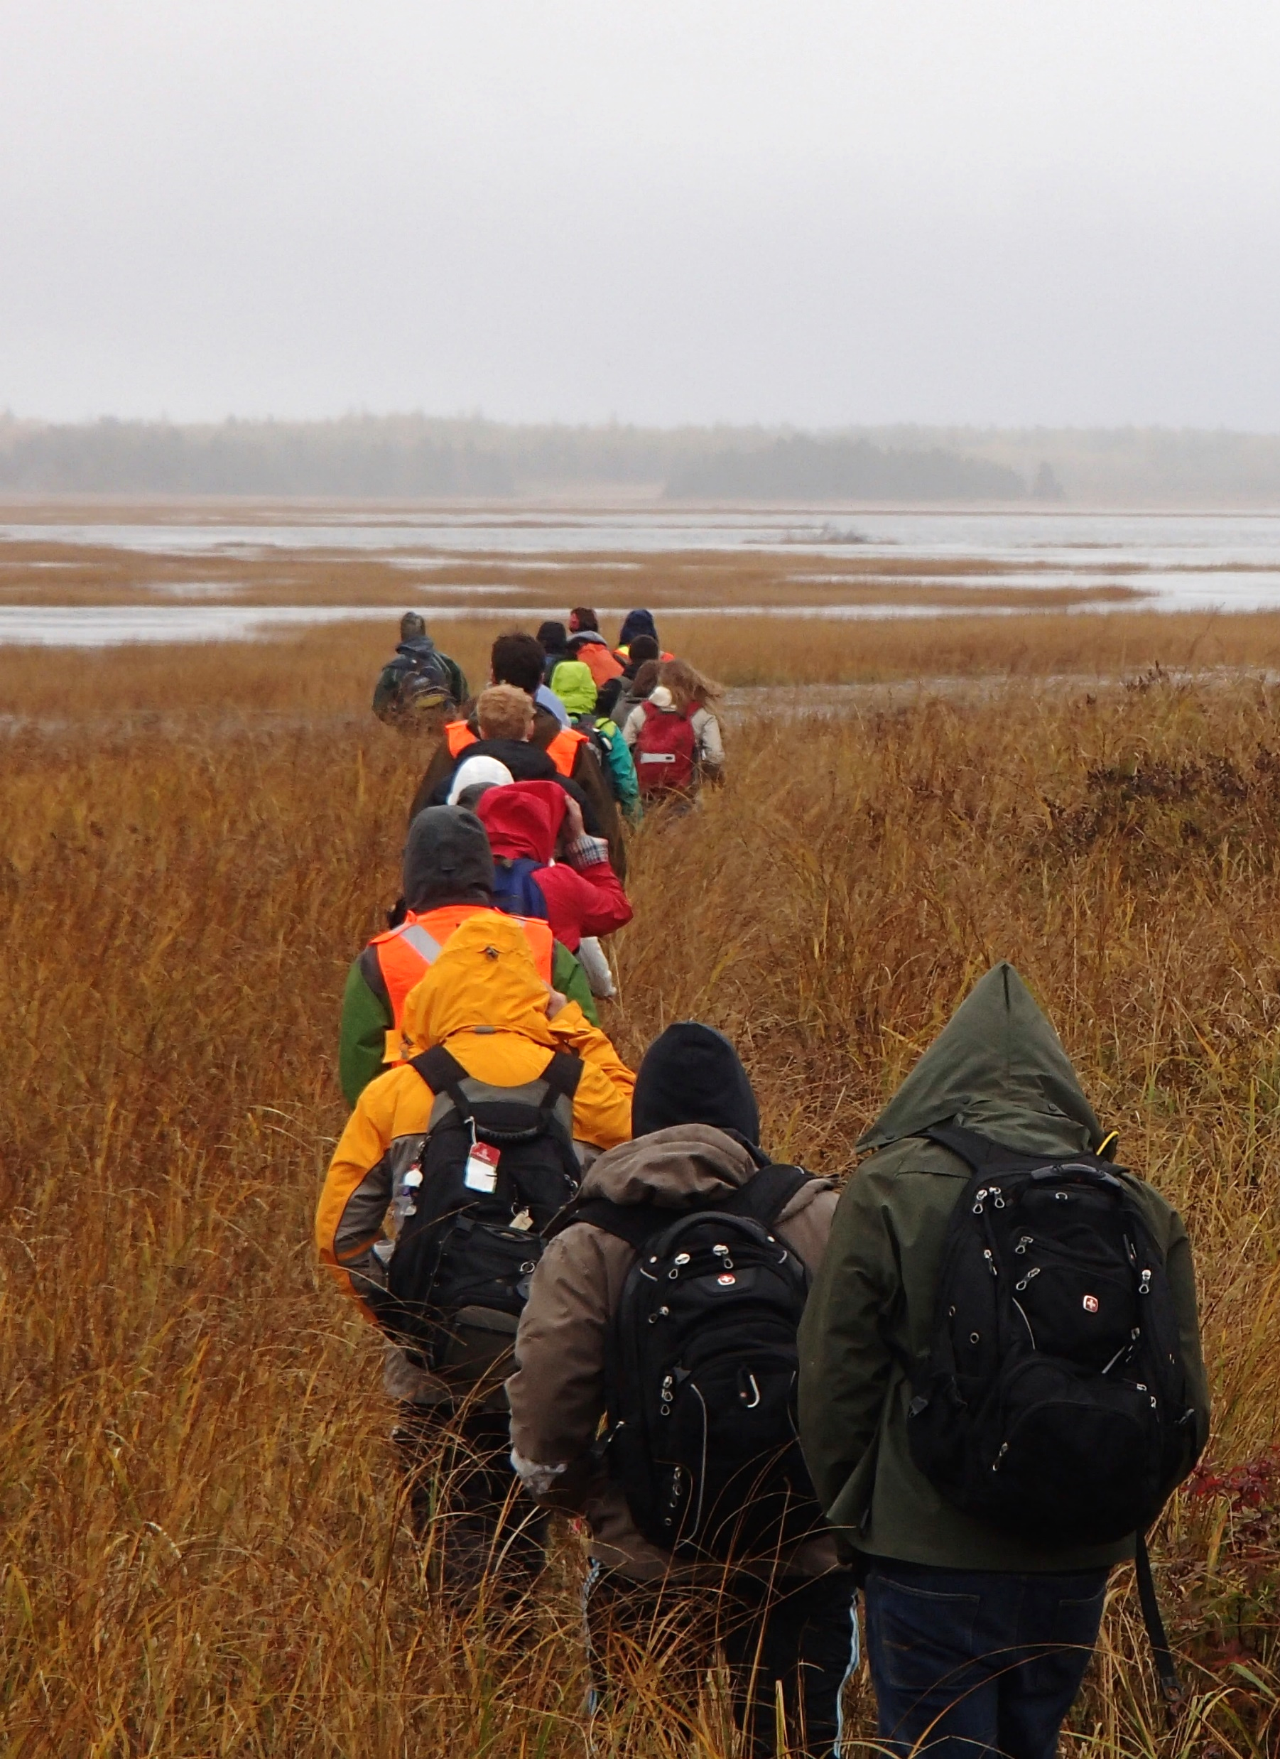

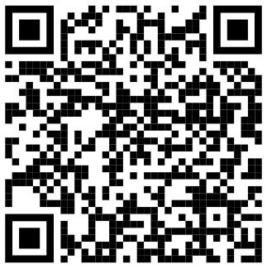
Geography & Environment
What You Learn
About Mount Allison
How to design and conduct field- and lab-based research in order to understand real-world environmental problems.
Located at the head of the Bay of Fundy in the town of Sackville, New Brunswick, Mount Allison is an institution defined by its geography. Consistently ranked as the top undergraduate school in Canada, Mount Allison students enjoy a high level of interaction with their professors and have many opportunities to do research with them.
Effective science communication to diverse audiences.
How to use key instruments and technology for better understanding environmental conditions, for example, sediment samplers, tree corers, multi-probe meters, microscopes.
Tools for data analysis: signal detection, impact analysis, and data interpretation.
For Environmental Science students who choose to pursue the department’s GIS courses, they will build:
Awareness of best cartographic practices and how to develop effective, attractive maps.
Visit us online or in person:
virtualtour..mta.ca
62 York Street, Sackville, NB, Canada E4L 1E2
admissions@mta.ca
(506) 364-2269
Core competence in the use of industry-leading GIS software.
Environmental Science

Slide 2
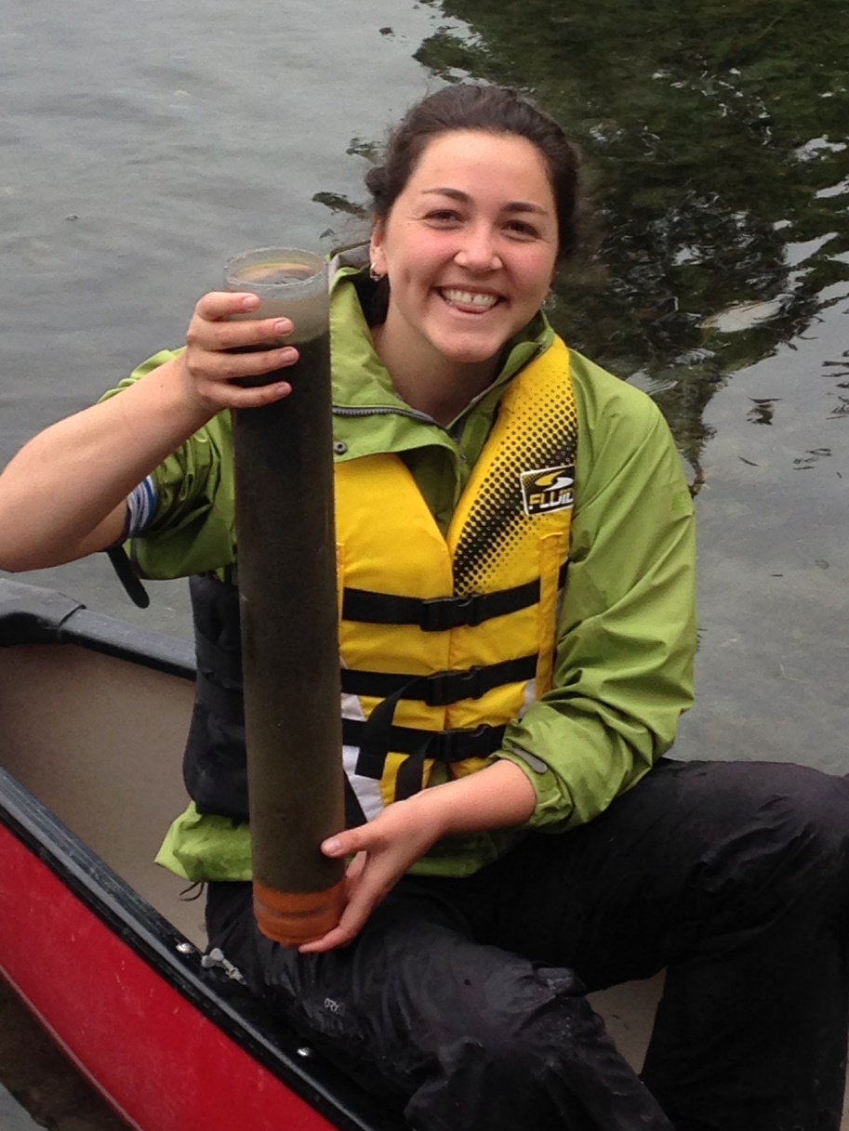
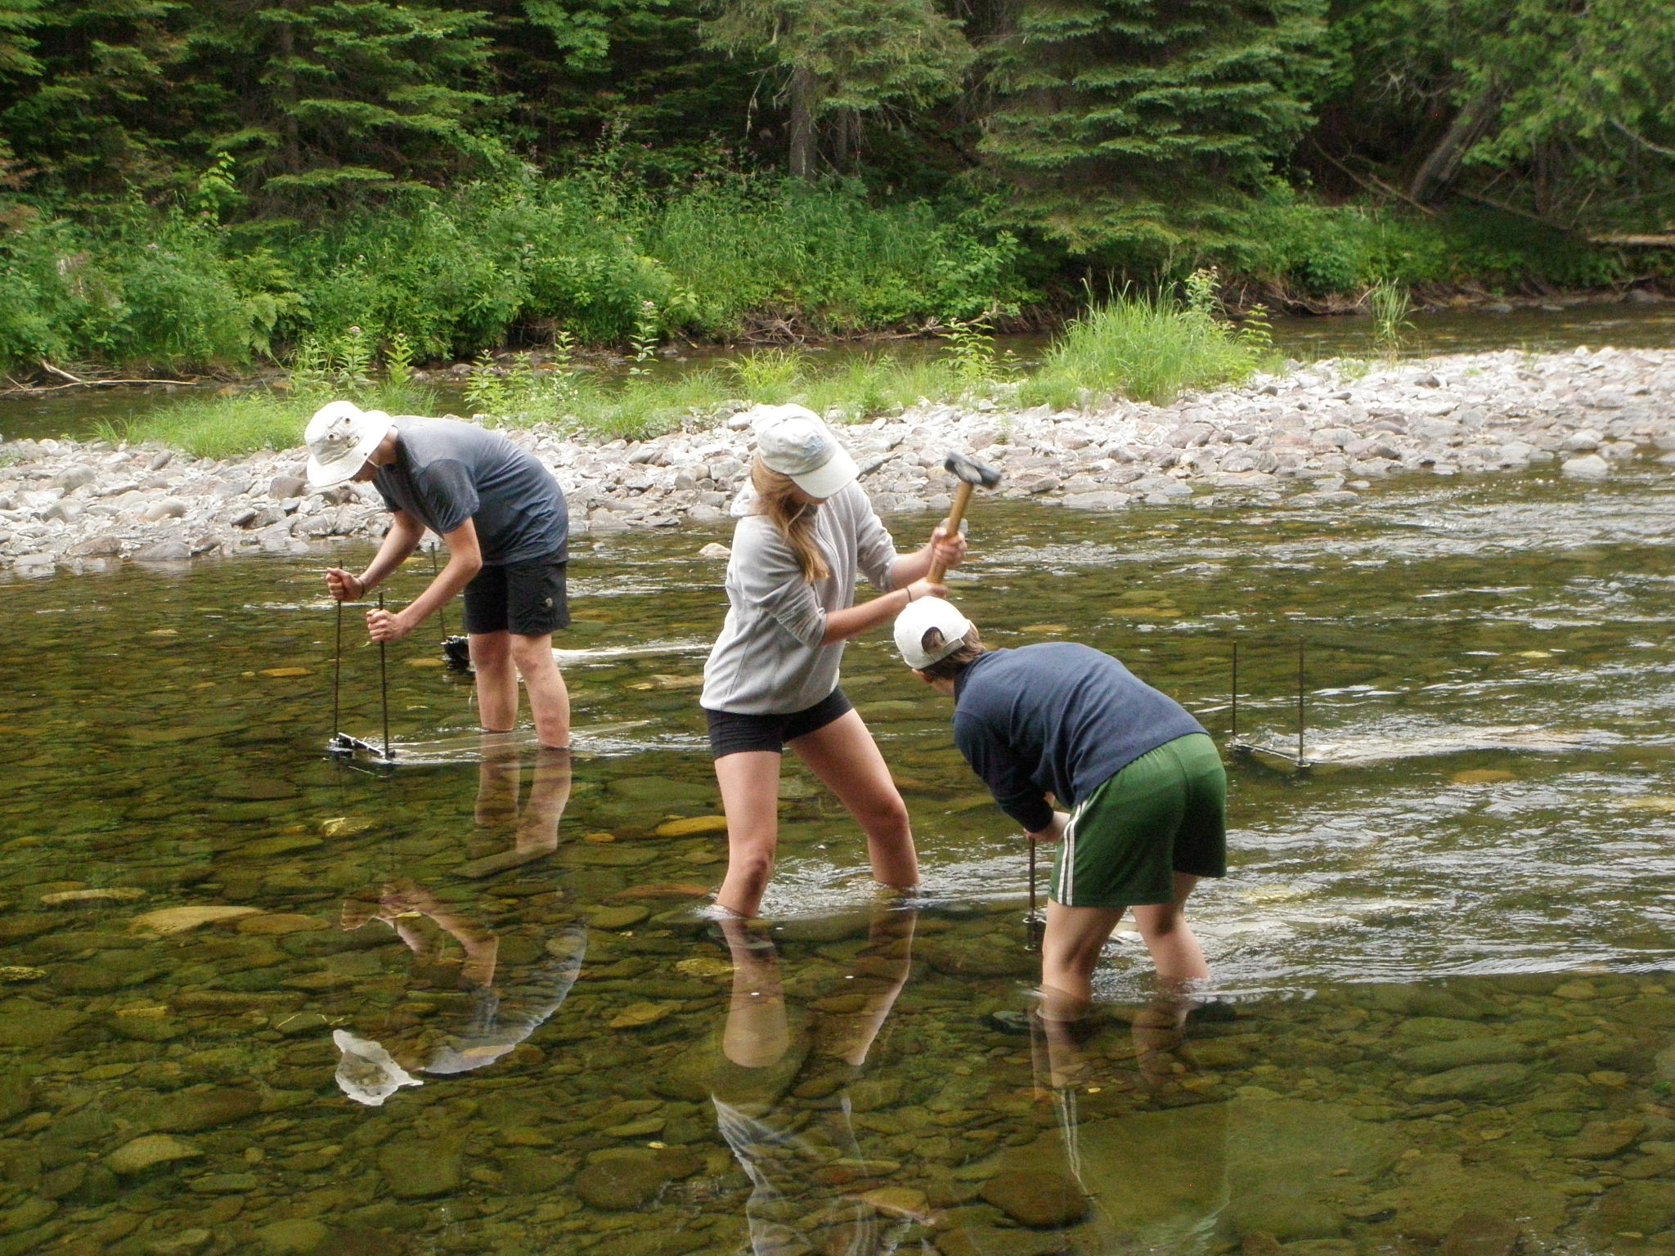
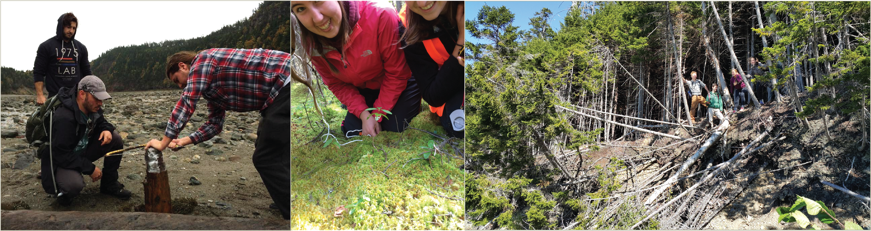
Environmental Science
@ Mount Allison
At Mount Allison University, students can pursue a Major, Minor, and Honours degree in Environmental Science in the Department of Geography and Environment.
A Sampling of Courses
Careers in Environmental Science
Physical Environment.
The program offers five optional streams to better prepare students for careers in the environmental sector:
Weather and Climate.
Data Analysis.
Biogeography.
Limnology.
Aquatic Environments: lake, stream and wetland health.
Why Environmental Science?
Biomonitoring.
Geographic Information Systems (GIS).
Environmental Chemistry
Global ecosystems are under threat from environmental change, both as a result of climate change and human activities.
Field Research Methods.
Opportunity to work at state-of-the-art facilities for environmental research, including:
Environmental Monitoring and Management: biodiversity monitoring, impact assessment, ecology of ecosystems.
The Environmental Science program is hands-on and field-based. It is also interdisciplinary, seeking to understand the linkages between human activity and impacts on natural environments.
Environmental Change and Aquatic Biomonitoring Lab (ECAB): http://www.ecablab.com
Environmental Modelling: computer modelling, simulation, Geographic Information Systems (GIS).
Geospatial Modelling Lab (GML): http://arcgis.mta.ca
"The Environmental Science Department at MTA opened my eyes to research opportunities that allowed me to explore the Maritimes in a unique way off the beaten trail. I am grateful of the one on one mentorship I was given…to advise me on my academics and push me to succeed out of my comfort zone at conferences and other types of science training. I also had the support to complete my degree from the department with a social and global perspective by going abroad and also studying political sciences alongside many hands on science courses. The experience that I have from MTA has gotten me a research position at Dalhousie where I plan to complete a Master's thesis with the School of Resources and Environmental Studies!" (Taylor Crosby, Environmental Science 2017)
By the time they have completed their degrees, students will have learned how to plan and execute their own research projects, analyze, interpret, and communicate the findings. Environmental Science graduates are well prepared for a wide-range of environmental careers focused on environmental monitoring, modelling, and assessment.

